Slide 1
Chap. 4: Datapath Design
Discusses the design of arithmetic units
  Basic “computer arithmetic” methods
4.1. Addition, subtraction, multiplication, and division
  All arithmetic functions can be “approximated”
4.2. Arithmetic Logic Units (ALUs)
4.3. Floating-point and pipeline processing

Slide 2
Unsigned Binary Addition
Decimal addition with fixed number of digits
3 + 4 = 7, 8 + 9 = 7 (with overflow = 10)
Half Adder
  Binary “1-digit” adder:
  0 + 0 = 0, 0 + 1 = 1, 1 + 0 = 1, 1 + 1 = 0
Full Adder
  Binary “1-digit” adder with carry-in & carry-out
  1 + 1 = 0 (cout = 1),
  1 + 1 + (cin = 1) = 1 (cout = 1)
modulo addition

Slide 3
Half Adder (HA) Implementation
Inputs x and y; output sum
x y sum
0 0 0
0 1 1
1 0 1
1 1 0
sum = x’ y + x y’
= x EX-OR y

Slide 4
Full Adder (FA) Implementation
Inputs x, y, cin; Outputs sum, cout
x y cin sum cout
0 0 0 0 0
0 0 1 1 0
0 1 0 1 0
0 1 1 0 1
1 0 0 1 0
1 0 1 0 1
1 1 0 0 1
1 1 1 1 1

Slide 5
Simple Adder Designs
Serial Binary Adder
  data enters serially, summed data exits serially
  Fig. 4.2 (p. 225)
Parallel Adder
  Fig. 4.3 (p. 226): n-bit ripple-carry adder (RCA)
  Fig. 4.4 (p. 226): n-bit adder-subtracter
Fast Parallel Adder
  based on “carry lookahead”

Slide 6
Carry Lookahead Addition
Generates carry out signal using only primary input signals (does not use “ripples”)
Key observations
  c_{i} is generated, regardless of the values of any other carry values, if (x_{i} AND y_{i}) is equal to 1
  c_{i} is propagated, depending on the value of c_{i-1}, if
  (x_{i} EX-OR y_{i}) is equal to 1
    NOTE: we can also use (x_{i} OR y_{i}) for the propagate term

Slide 7
Multiplication
Combinational Multiplier
  Typically uses an array of CSA (carry save adder) modules
  Trades off space (hardware) for time (calculation speed)
Sequential Multiplier
  Executes a sequence of add-and-shift operations
  Tries to minimize number of add-and-shifts required
  Advantage: can use existing registers and ALU
  Disadvantage: slower than combinational version
[Lee 2000]

Slide 8
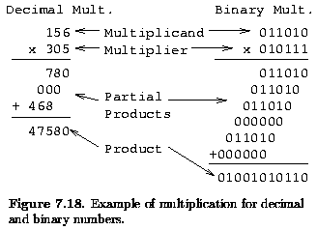
Multiplication H/W
Based on paper-and-pencil method of repeated shift-and-add operations

Slide 9
Observations
Multiplication of single digits in binary multiplication is just an “AND” operation
Multiplication of two n-bit numbers can be accomplished with (n-1) additions
Can use array of AND gates, HA’s, and FA’s
  Figs. 4.17, 4.18, 4.19 (pp. 242-243) --> CSA
Question: Where is most of the “delay” in this design?

Slide 10
Sequential Multiplication
Use one parallel adder, a set of registers (capable of shifting), and control logic
Use the ASM design method to design this circuit
Multiplier “recoding” can be used to reduce the number of adds and subtracts required
  Booth’s Algorithm, Booth Multiplier
  Modified Booth Multiplier

Slide 11
Multiplication with Signed Numbers
Case 1: multiplier X and multiplicand Y are positive
Case 2: X is positive and Y is negative
  sign-extend the partial products during shifting
    use the msb (most significant bit) of the partial product
Case 3: X is negative and Y is positive
  add 1 final step of subtracting Y from the partial product
Case 4: both X and Y are negative
  apply methods for both Case 2 and Case 3

Slide 12
Booth’s Algorithm
Suppose X = 0111 1110. What is X in base 10?
  X = 64 + 32 + 16 + 8 + 4 + 2 = 126
  X = 128 – 2 = 126
  This works in general → refer to p. 239
  A “run” of 1’s can be replaced by 1 add & 1 subtract
  X can be “recoded” as X* = 1000 0010, where 1 denotes “add” and 1 denotes “subtract”
    Called “differentiating recoding”
Algorithm shown in Figs. 4.15, 4.16 (pp. 240-241)

Slide 13
Division
Sequential Divider
  Executes a sequence of subtract-and-shift operations
  Tries to minimize number of add-and-shifts required
  Advantage: can use existing registers and ALU
  Disadvantage: slower than combinational version
Combinational Divider
  Uses an array of 1-bit subtracter modules
  Trades off space (hardware) for time (calculation speed)

Slide 14
Sequential Division H/W
Based on paper-and-pencil method of repeated subtract operations
  Note: quotient bit needs to be “guessed”)
Two basic methods available
  Restoring division
    restore partial remainder if guess is wrong
  Nonrestoring division
    change next subtract step to addition if guess is wrong
More advanced methods based on other guessing (deduction) methods

Slide 15
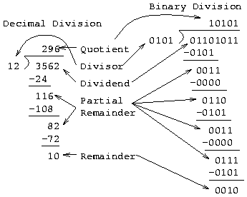
Paper-and-pencil Division Method

Slide 16
Arithmetic Logic Unit (ALU)
Uses of the ALU
  process arithmetic and logical instructions
  address calculations
  act as a data conduit (route data between two points)
ALU Design Techniques
  many advanced transistor-level design techniques used to achieve fast ALU designs
  gate-level designs can be “flattened” for better performance
  basic ALU design is fairly simple

Slide 17
Design of One Bit of ALU
ALU can be designed as an adder that can conditionally perform other functions based on the selection of control inputs
ALU designed as a chain of identical 1-bit adders
  may not be efficient for large numbers of bits
Adder functions
  sum = x EX-OR y EX-OR cin
  cout = (x AND y) OR (y AND cin) OR (x AND cin)
Alternative ALU designs shown in Sec. 4.2

Slide 18
Floating-Point Arithmetic
IEEE Standard for floating-point numbers based on draft proposed by Kahan et. al. in 1979.
X = (F_{X}, E_{X}), where F_{X} = mantissa, E_{X} = exponent
Multiplication: multiply mantissas, add exponents
Division: divide mantissas, subtract exponents
Addition: shift one mantissa and add
Subtraction: shift one mantissa and subtract

Slide 19
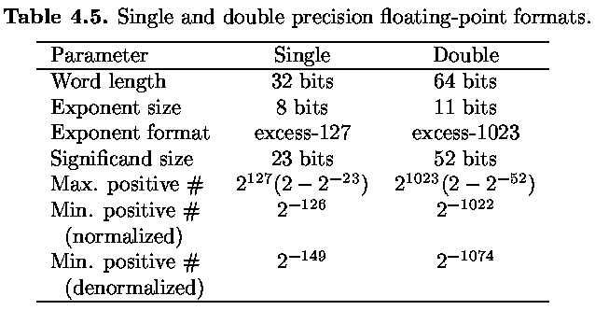
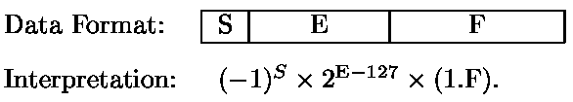

Slide 20
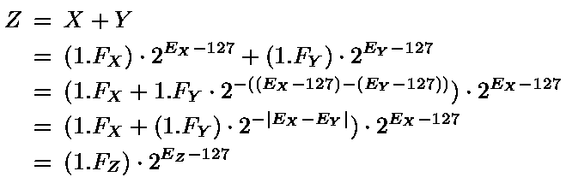
Floating-Point Addition Process (Assuming Positive Numbers)

Slide 21
Floating-Point Addition Units
Similar algorithm shown in Fig. 4.42
Example of algorithm execution shown in Fig. 4.43
Floating-point addition unit for IBM System/360 shown in Fig. 4.44

Slide 22
Floating-Point
In recent years it has become more common to implement fixed point and floating point instruction in separate units, a fixed-point or integer unit FXU and a floating-point unit FPU. This separation makes it possible for fixed point and floating-point instruction to be executed in parallel. [Fig: 4.41]

Slide 23
Coprocessor
Complicated arithmetic operations like exponentiation and trigonometric functions are costly to implement in CPU hardware, while software implementations of these operations are slow. A design alternative is to use auxiliary processors called arithmetic coprocessors to provide fast, low-cost hardware implementations of these special functions. In general, a coprocessor is a separate instruction set processor that is closely coupled to the CPU and whose instructions and registers are direct extensions of the CPU’s. [Fig: 4.45]

Slide 24
Coprocessor
A coprocessor instruction typically contains the following three fields:
    An opcode F₀ that distinguishes coprocessor instructions from other CPU instructions.
    The address F₁ of the particular coprocessor to be used if several coprocessors are allowed.
    The type F₂ of the particular operation to be executed by the coprocessor.

Slide 25
Pipeline Processing
Pipelining is a general technique for increasing processor throughput without requiring large amounts of extra hardware.
It is applied to the design of the complex datapath units such as multipliers and floating-point adders.
It is also used to improve the overall throughput of an instruction set processor [More details in Chap 5].

Slide 26
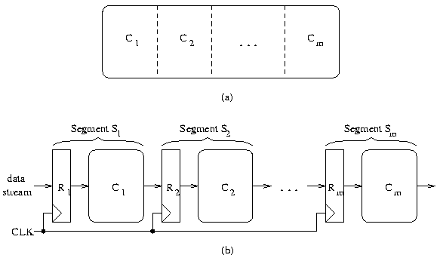
Pipeline Processing: Basic Structure
Data in
Data out

Slide 27
Pipeline Processing: Basic Structure
A pipeline processor consists of a sequence of m data-processing circuits, called stages or segments, which collectively perform a single operation on a stream of data operands passing through them.
Some processing takes place in each stage, but a final result is obtained only after an operand set has passed through the entire pipeline.
As illustrated in Fig (b), a stage S_{i} contains a multi-word input register or latch R_{i}, and a datapath circuit C_{i} that is usually combinational.
The R_{i}’s hold partially processed results as they move through the pipeline; they also serve as buffers that prevent neighboring stages from interfering with one another.
A common clock signal causes the R_{i}’s to change state synchronously.

Slide 28
Pipeline Processing: Basic Structure
Each R_{i} receives a new set of input data D_{i – 1}from the preceding stage S_{i – 1} except for R1 whose data is supplied from an external source.
D_{i – 1}represents the results computed by C_{i- 1}during the preceding clock period.
Once D_{i – 1}has been loaded into R_{i}, C_{i} proceeds to use D_{i - 1} to compute a new data set D_{i}.
Thus in each clock period, every stage transfers its previous results to the next stage and computes a new set of results.

Slide 29
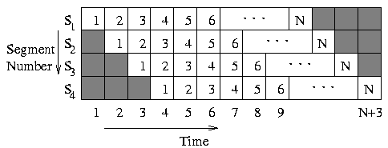
Speedup
  Speedup(pipeline) = Time(no pipeline) / Time (pipeline)
Space-Time Diagram
Efficiency
  Ratio of “numbered blocks” to total number of space-time blocks
  What is the efficiency of an ideal m-stage pipeline operating on N data items?

Slide 30
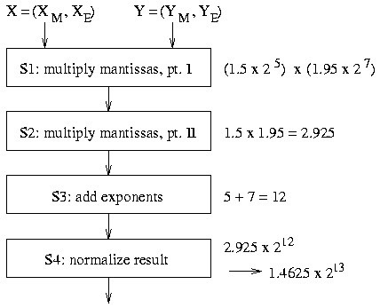
Example Pipeline Structure
Linear
Pipeline
Structure
for
Floating-point
Multiplication

Slide 31
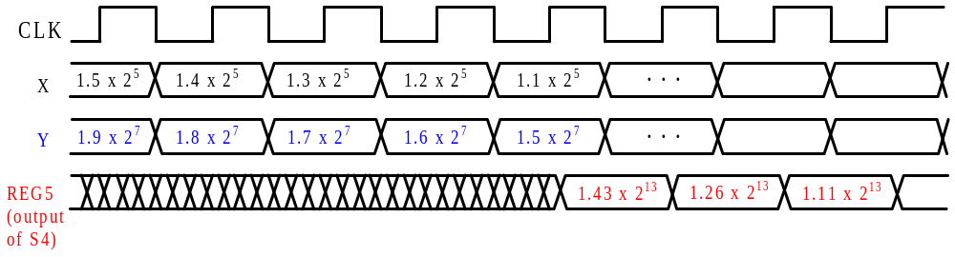
Example Timing Diagram
After 4 clock cycles, there is one
output result every clock cycle

Slide 32
Categorization of Pipeline Structures
Based on Function
  Instruction pipeline
  Arithmetic pipeline (e.g., multiplier pipeline)
Based on Structure
  Linear / Nonlinear
  Static / Dynamic (multi-function)
  Scalar / Vector

Slide 33
Simple Instruction Pipelines
Static linear pipeline of about 2-8 stages
Difficulties with simple static linear pipelines
  Variations in instruction execution times
  Variations in instruction lengths
    Different number of accesses to memory to fetch instruction
    Cannot quickly determine location of next instruction
  Thus, instruction sets should be designed so that the resulting architectures are easily pipelined
    Set of fixed-length, similar-complexity instructions

Slide 34
Instruction Pipeline Control
ASM Chart Method
  Changes ASM chart to fetch the next instruction while the current instruction is being executed.
Pipelined Control Signals
  Control logic generates control signals in the first stage
  Control signals are pipelined along with the instructions

